Slide 2
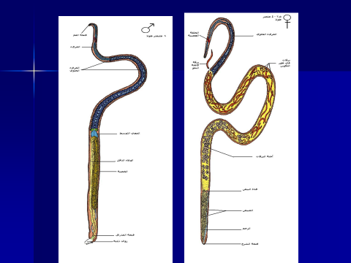

Slide 4
2
1

